Slide 1

Hotel bookings and the effect of cancellations
Institute of Data – Capstone Project
By Anthony Tan

Slide 2

Business on the Books
BOB

Slide 3
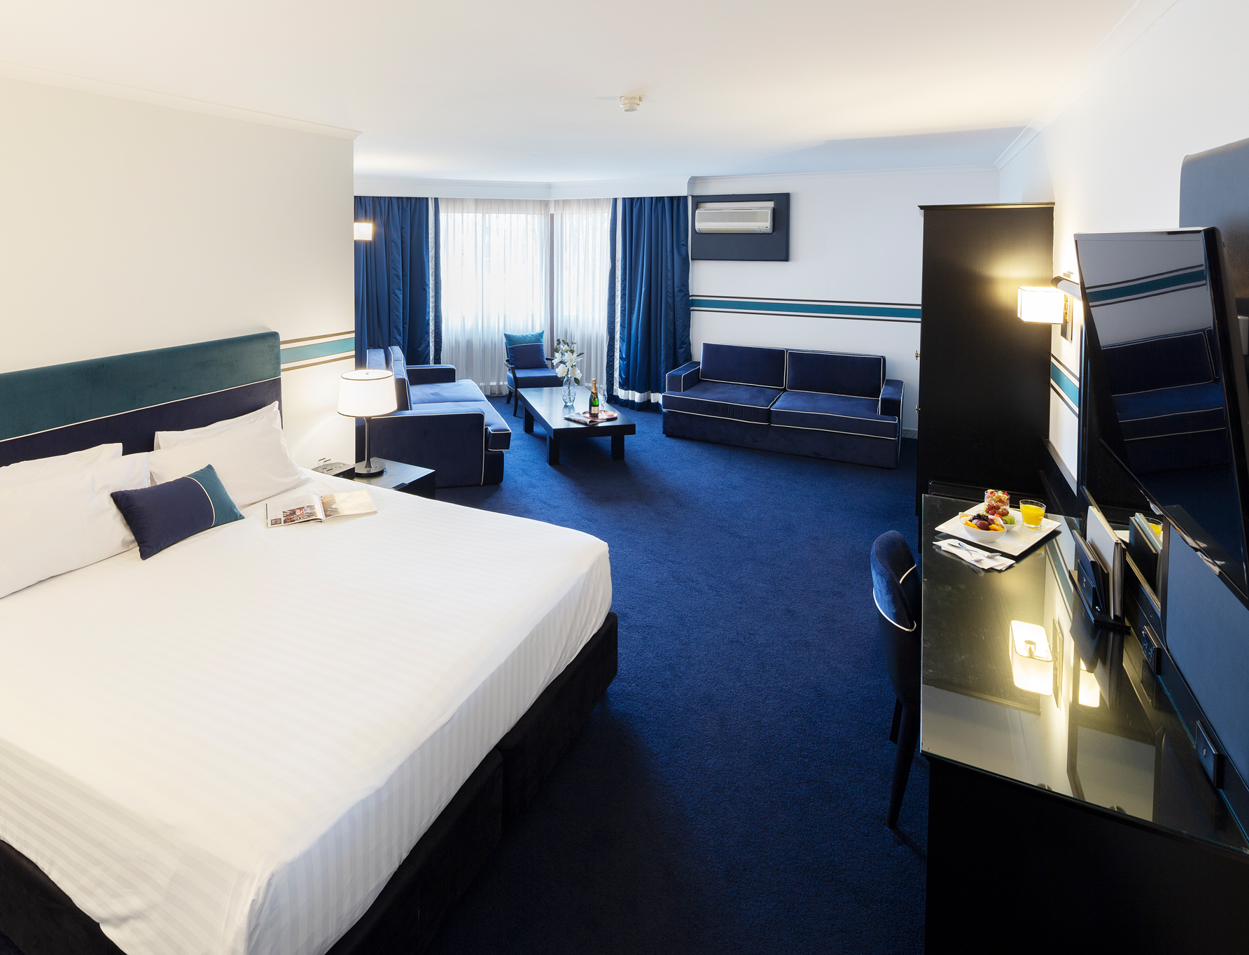
Agenda
Background
Business Question
Data Analysis
Model Evaluation
Conclusion

Slide 4
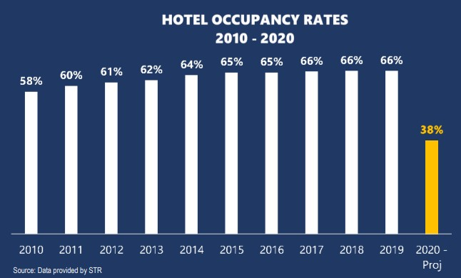
The impact of Covid-19 on hotels
Lowest year on record for hotel occupancy
Greater than 50% revenue decline, approx. $112 billion lost
Impact to travel industry nine times worse than 9/11
Source: https://www.ahla.com/covid-19s-impact-hotel-industry

Slide 5
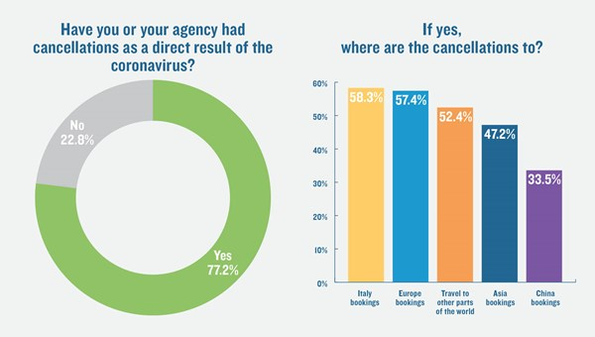
What region has been most affected?
Source: https://www.travelweekly.com/Travel-News/Travel-Agent-Issues/Travel-Weekly-readers-poll-Cancellations-piling-up-coronavirus

Slide 6
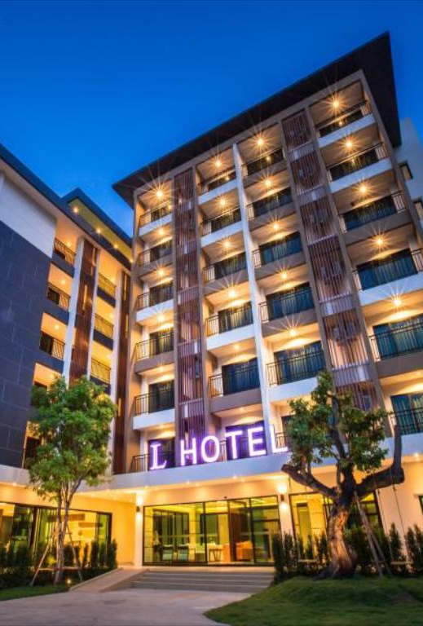
Solving the business problem
Business Question
How can we minimize hotel booking cancellations and retain business?
Data Question
What specific variables from a hotel booking have the most influence on a cancellation?
Why?
Knowing the likelihood of a cancellation can help with business strategies in the interest of stakeholders (owners and management).

Slide 7
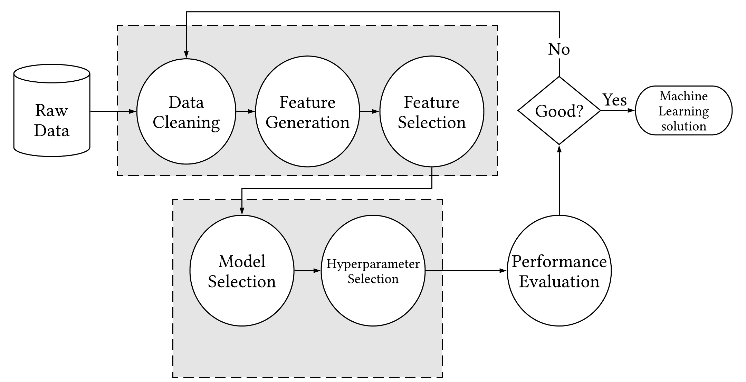
Pipeline

Slide 8

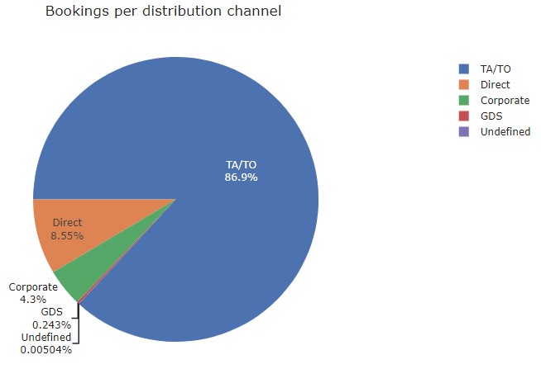
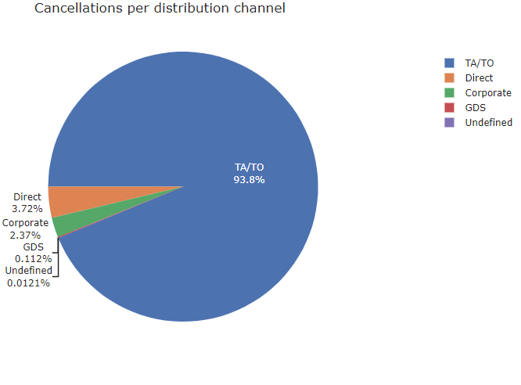
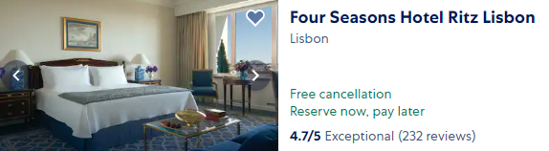
Where do the bookings come from?
Over 85% bookings made via TA/TO (Travel Agents / Tour Operators) and third party sites
Over 90% cancel via TA/TOs
These channels actively promote "free" cancellation policies to generate bookings through their system

Slide 9
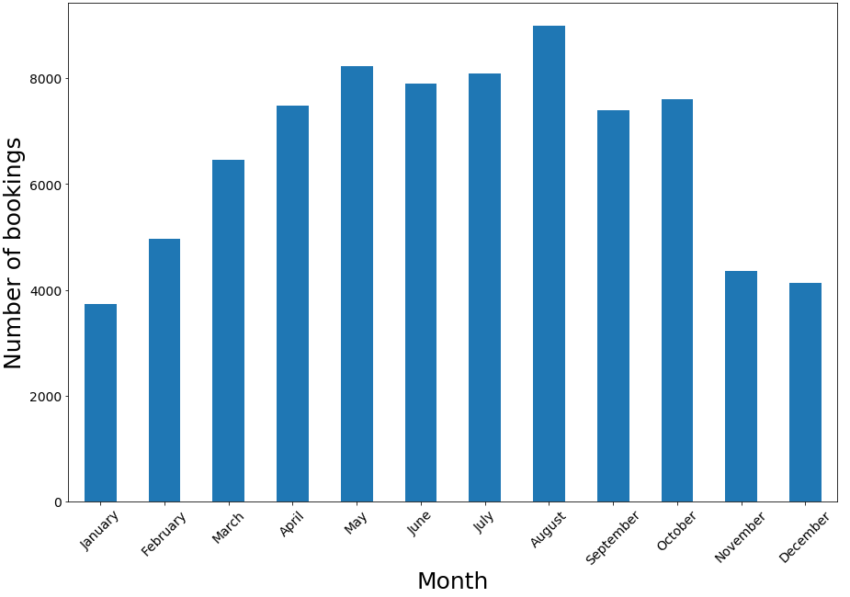
Bookings Per Month
Data consists of 79,330 records and 32 features (e.g. dates, room rate, market segment)
Peak season is during summer months and slows down as winter approaches

Slide 10
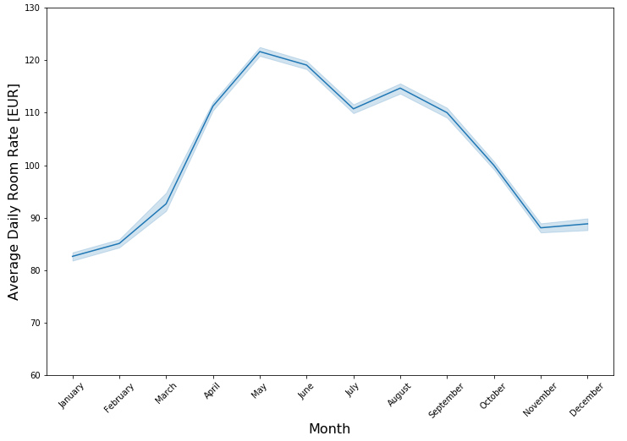
Average Daily Room Rate
Average Daily Rate (ADR) follows a similar seasonal pattern to booking volume.
Peak season rate 1.5 times higher than low season
Low season: €300K average monthly potential earnings
High season: €950K average monthly potential earnings

Slide 11
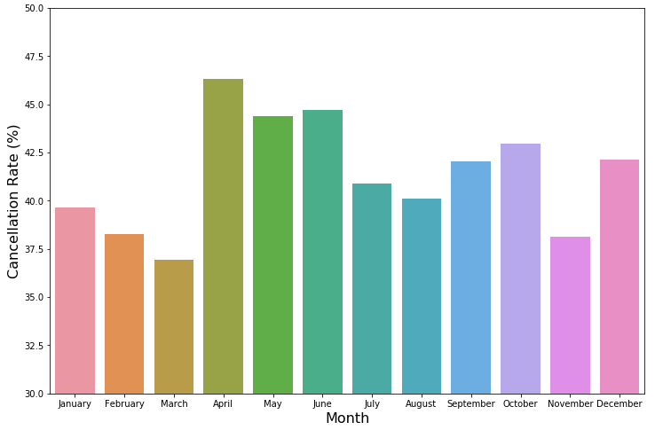
Cancellations Per Month
Cancellations not as consistent with seasonality of booking volume and room rate
Percentage tends to be greater over high seasons, resulting in bigger loss in revenue.

Slide 12
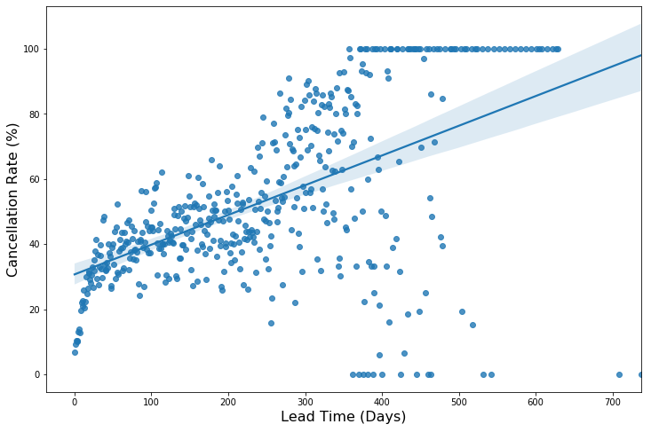
Lead Time
Lead Time: Duration between date of customer making booking and actual arrival date
Longer lead time has higher probability of cancellation
30% cancelling within 24 hours of arrival vs. 60% cancelling 12 months before arrival

Slide 13
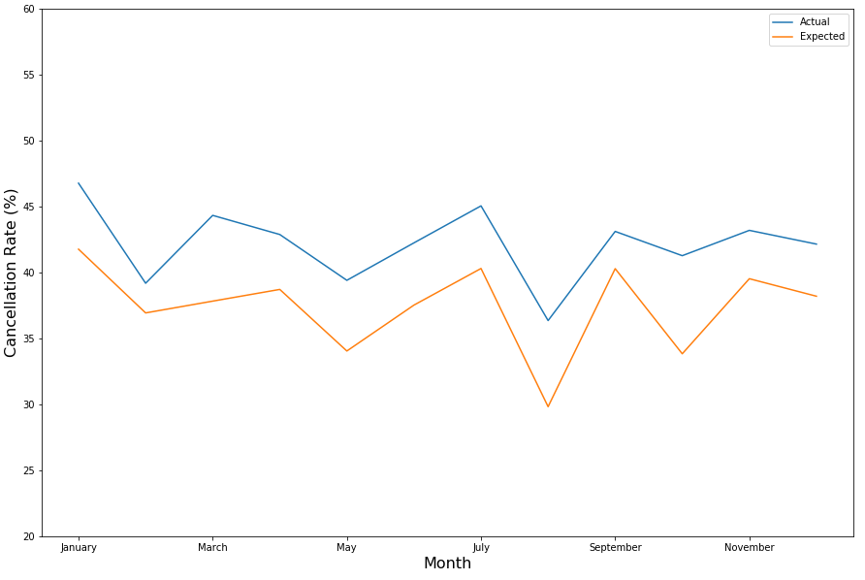
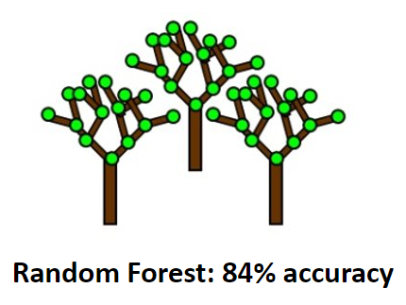
Actual vs. Expected

Slide 14
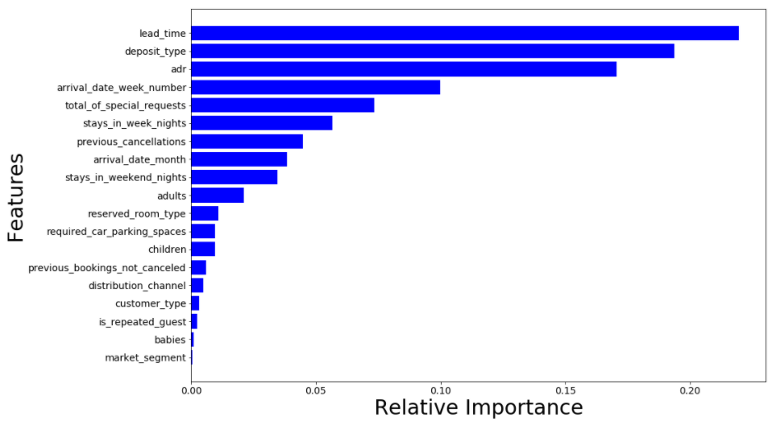
Machine Learning Model Evaluation

Slide 15

Recommendations
Advance purchase discount incorporates both lead time and deposit
Stricter cancellation policy during peak seasons to reduce risk of cancellations on high rates
If booking meets certain criteria that has high probability of cancellation, hotel can make contact with guest to provide personalized customer service

Slide 16
Summary
Objective
Identify which specific features result in booking cancellation
Process
Random Forest provided best performance with 84% accuracy
Select most relevant features that affect cancellation
Reduce cancellations of hotel bookings
Recommendations
Build prediction model to determine which factors influence the outcome with most accuracy
Lead time, deposit, and average rate had most impact on target

Slide 17



Slide 18


